Slide 1
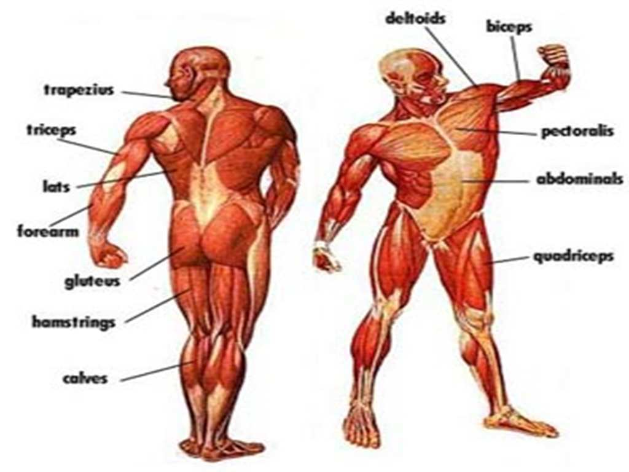
The Muscular System

Slide 2
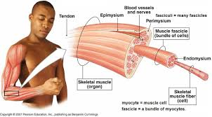
Levels of Organization
Cells – muscle cells, blood cells, nerve cells, etc.
Tissue – smooth muscle tissue, cardiac muscle tissue, skeletal muscle tissue, etc.
Organ – muscles (biceps, triceps, hamstring, etc.)
Organ System – muscular system
Organism – individual animals

Slide 3
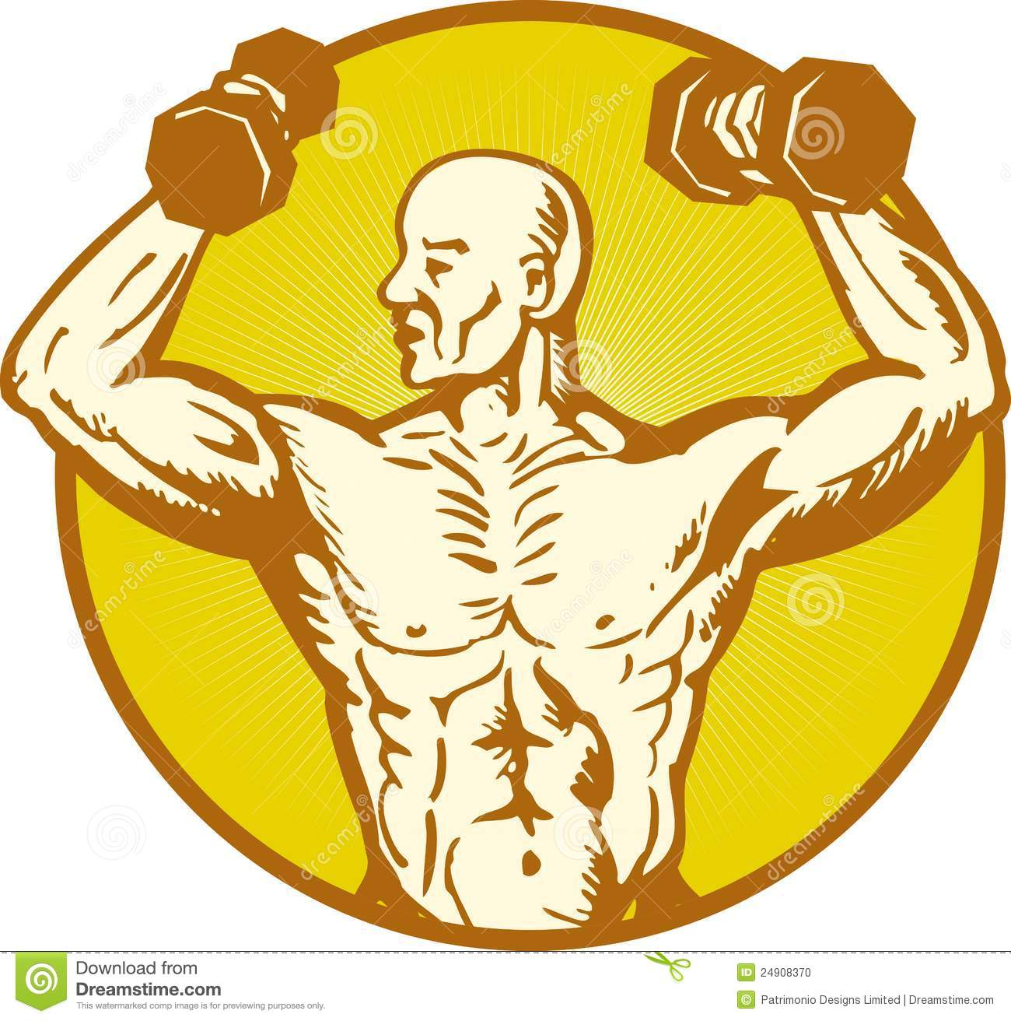
Major Functions of the Muscular System
1. Moves the skeleton (with the skeletal system)
2.Movement inside internal organs
3. Maintains your posture
and body position
4. Generation of body heat

Slide 4
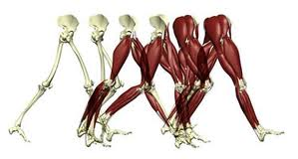
1. Moves the skeleton (with the skeletal system)
The muscular and skeletal system work together to move your body.
We have approximately 640 skeletal muscles.
Most of these muscles work in pairs.
Muscles contract to move your bones.
Tendons connect muscles to bones.

Slide 5
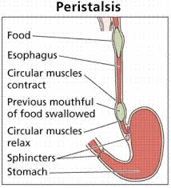
2. Movement inside internal organs
Keep your heart beating (cardiac muscle).
Every time your heart beats it contracts and sends blood out to your body or lungs.
When it relaxes, it allows blood back in.
This is similar to when you squeeze a tube of toothpaste sending the toothpaste out of the tube.
Beware! Live human heart beating during surgery.
Move breath in and out of our lungs with our diaphragm Breathing video
Move food through the digestive system (smooth muscles you can’t control)
and blood through veins and arteries

Slide 6
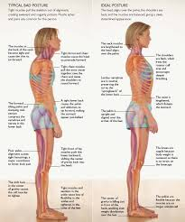
3. Maintains your posture and body position
Muscles often contract to hold the body still or in a particular position rather than to cause movement.
The muscles responsible for the body’s posture have the greatest endurance of all muscles in the body—they hold up the body throughout the day without becoming tired.

Slide 7
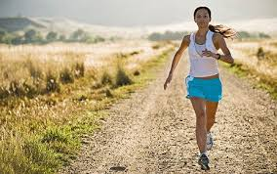
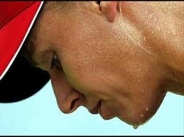
4. Generation of body heat
Our muscular system produces a great deal of waste heat from burning the ATP made during cellular respiration.
Many small muscle contractions within the body produce our natural body heat.
When we exert ourselves more than normal, the extra muscle contractions lead to a rise in body temperature and eventually to sweating.

Slide 9
WARNING!!!
Graphic slide coming.

Slide 10
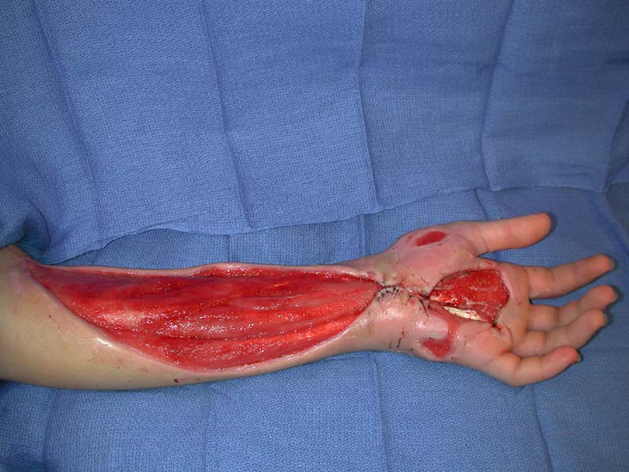
Muscles – How do they work?
There are over 600 muscles in the human body.

Slide 11
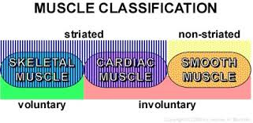
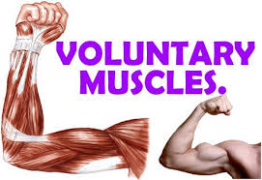
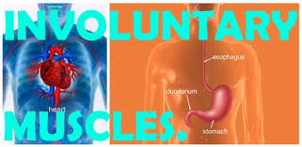
Types of muscles
There are two categories of muscles.
1) Involuntary - muscles that are NOT under your control. They will perform a specific function all on their own without your control.
Example: breathing, digesting food, heart beating
2) Voluntary - muscles that you have total control over. You make them move.
Example: walking. chewing, talking

Slide 12
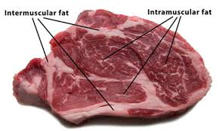
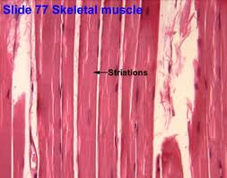
Muscle Fiber
Muscle Fiber - Long fibers that run parallel to each other and are held together by connective tissue.
Muscles contract and relax.
Muscles can only pull, they can’t push.

Slide 13
Within these categories are three types of muscle tissue:
Skeletal
Cardiac
Smooth

Slide 14
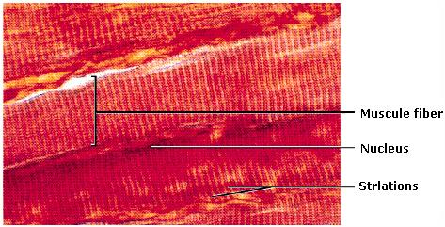
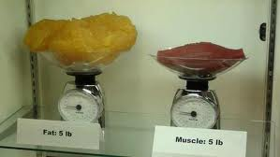
Skeletal Muscle Tissue
1) Skeletal (striated) muscle – this is the muscle tissue that is connected to the bones.
Skeletal (striated) muscles appear banded or striated.
These muscles tire quickly. (voluntary)
Example: bicep, triceps, quadriceps, abdominals, hamstrings

Slide 15
Clothespins and Muscle Fatigue
Questions coming about this so read carefully!
In order to contract (move), your muscles require
energy in the form of ATP. (Adenosine Triphosphate)
Muscles can produce ATP in two different ways.
We have discussed aerobic respiration where oxygen
is required.
The second way is called anaerobic respiration which does NOT require oxygen.
Anaerobic respiration in muscles cells produces lactic acid.
When muscles do a lot of work quickly, the buildup
of lactic acid reduces their ability to contract, until
eventually exhaustion sets in and contraction stops
altogether.
This is called muscle fatigue.

Slide 16
Clothespins and Muscle Fatigue
1. What is the type of energy that a muscle needs in order to contract?
In order to contract (move), your muscles require energy in the form of ATP.
2. What is produced when there is no oxygen present for the muscle cells?
Lactic Acid
3. When muscles do not use oxygen, what form of respiration is this?
Anerobic respiration in muscles cells produces lactic acid.
4. What causes muscle fatigue?
When muscles do a lot of work quickly, the buildup of lactic acid reduces their ability to contract, until eventually exhaustion sets in and contraction stops altogether.

Slide 17
WARNING!!!
The next 2 slides have graphic pictures.

Slide 18
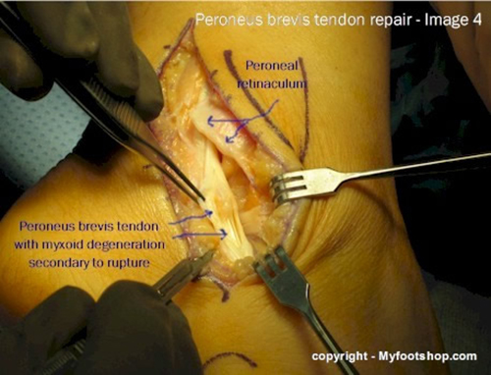
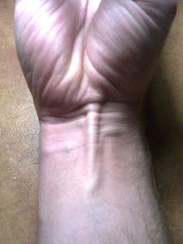
Tendon
In order for muscles to move the bone, the muscle must attach to the bone. This is through a strong connective tissue called TENDON.
Tendons connect muscle to bone.

Slide 19
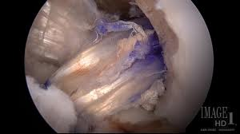
Tendons
A hamstring tendon has been used to reconstruct the ACL in the patient above. The tendon runs from upper right to lower left.

Slide 20
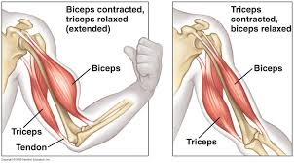
How do muscles work?
Muscles work in pairs !
This is because muscle cells can only contract and relax. Skeletal muscle must work in pairs, while one contracts the other relaxes.

Slide 21
WARNING!!!
Graphic slide coming.

Slide 22
Musculature of human arm

Slide 23
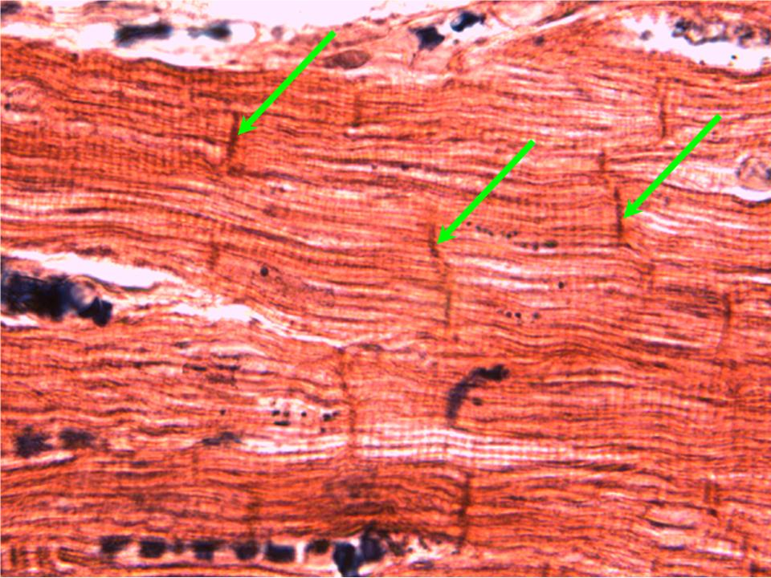
Cardiac muscle
Cardiac muscle- This muscle makes up the heart. (involuntary)
The only place cardiac muscle is found is in the heart.
It is the muscle that keeps our heart beating.
Example: heart
Striated like skeletal muscle
Doesn’t tire like skeletal muscle

Slide 24
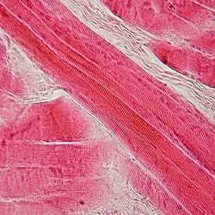
Smooth Muscle
Smooth muscle- This is muscle tissue that is in many of your internal organs. (involuntary)
Where found: lining your blood vessels, muscles in your stomach, your bladder, your eyes
Smooth muscles work by sending a signal in a wave over several cells (peristalsis).
This wavelike action helps in moving food through the intestine.
NOT striated
Reacts slower than skeletal muscles
Tires more slowly than skeletal muscles

Slide 25
Fun Facts about the Muscular System
The word muscle is derived from the Latin term musculus, meaning "little mouse". This Latin term could be due to the shape of some muscles or because muscles contracting under the skin can look like a mouse moving under a rug.
The strongest muscles in relation to the job they have to do is the external muscles of the eye which are large and about 100 times stronger than they need to be in relation to the small size and weight of the eyeball.
There are muscles in the root of your hair that give you goose bumps.
The largest muscle in your body is your gluteus maximus.
The tongue has 8 muscles, so is technically not the strongest muscle in the body. (see #7 on link)
More interesting facts about your muscles.

Slide 26
girl lifting weights

